Slide 1
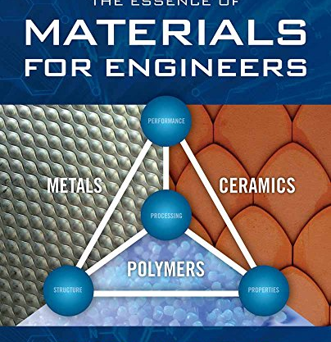
Material Selection - Case study Automobile
By Dr Rino Nelson

Slide 2
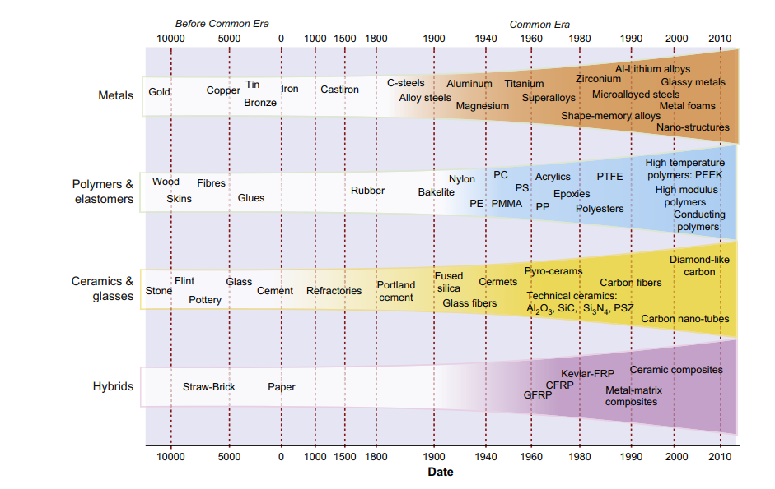
Evolution of Materials
Why material selection
→ achieving the required function
→ cost-effective with project and product development goals.

Slide 3
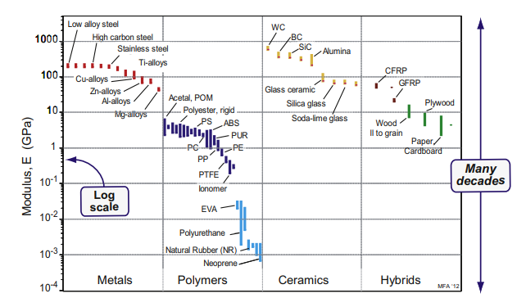
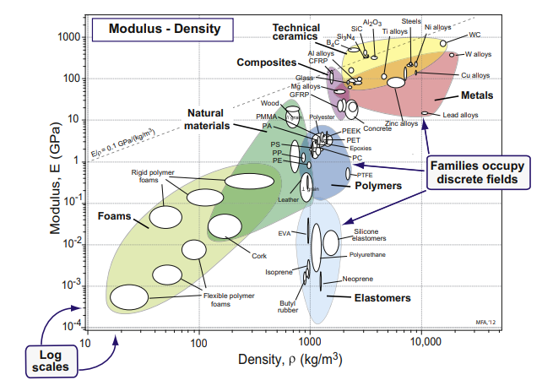
Material property charts
Data sheets for materials list their properties, but they give no perspective and present no comparisons. The way to achieve these is to plot material property charts.
They are of two types: bar charts and bubble charts.

Slide 4
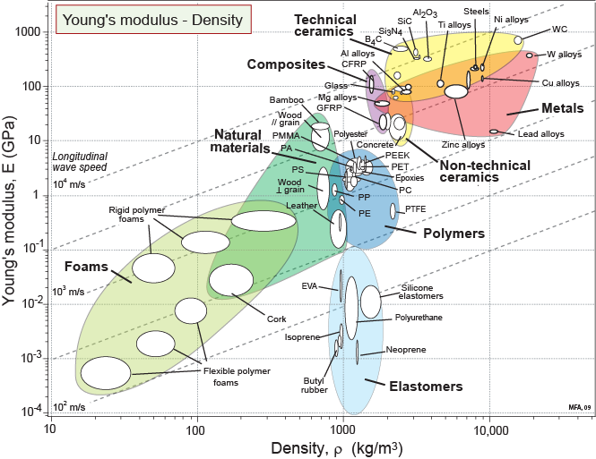
Material property charts
Composition, microstructure and architecture
Crystalline materials:
Composition – metallic bond vs. ionic/covalent bonds.
Composites:
Architecture –
Components, lay-up
Natural
materials:
Composition,
microstructure,
architecture
Polymers & Elastomers:
Composition & Microstructure – hydrogen-bonded C-chains;
cross-linking and crystallinity.
Foams:
Architecture –cell structure

Slide 5
Function, constraints, objectives and free variables
It define the boundary conditions for selecting a material
Function | What does the component do?
Constraints | What non-negotiable conditions must the material meet?
Objectives | What aspects of performance are to be maximised or minimised?
Free variables | What parameters of the problem is the designer free to change?

Slide 6
Function, constraints, objectives and free variables
Stiff beam of length L and minimum mass
Function
Beam
b
F
b
Square
section,
area
A = b²
L
δ
Constraints
Length L is specified
Must have bending stiffness > S*
Equation for constraint on A:
m = mass
A = area
L = length
ρ = density
S = stiffness (F/δ)
This beam: δ = FL³/CEI
C = constant (here, 48)
E = Young’s modulus
I = second moment of area
(I = b⁴/12 = A²/12)
Objective
Minimize mass m:
m = A L ρ
Performance metric
Chose materials
with largest

Slide 7
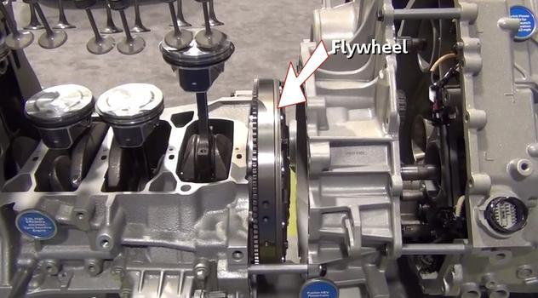
Flywheel
Flywheels → store energy
More recently flywheels have been proposed for power storage and regenerative braking systems for vehicles
Lead, cast iron, steel, composites—there is a strange diversity– will these materials work
What is the best choice of material for a flywheel?

Slide 8
Constrains
An efficient flywheel stores as much energy per unit weight as possible.
As the flywheel is spun up, increasing its angular velocity, ω, it stores more energy.
The limit is set by failure caused by centrifugal loading: if the centrifugal stress exceeds the tensile strength (or fatigue strength), the flywheel flies apart.
One constraint, clearly, is that this should not occur.
For the flywheel of an automobile engine—we wish to maximize the energy stored per unit volume at a constant (specified) angular velocity.
There is also a constraint on the outer radius, R, of the flywheel so that it will fit into a confined space.

Slide 9
Design Matrix – Flywheel
 | For maximum-energy flywheel | For fixed velocity
Function | Flywheel for energy storage | Flywheel in toys
Constraints | Outer radius, R, fixed Must not burst Adequate toughness to give crack-tolerance | Outer radius, R, fixed
Objective | Maximize kinetic energy per unit mass | Maximize kinetic energy per unit volume at fixed angular velocity
Free variables | Choice of material | Choice of material

Slide 10
Flywheel – Design Constrain
An efficient flywheel of the first type stores as much energy per unit weight as possible, without failing.
The mass of the disk is

Slide 11
Flywheel – Design Constrain
The quantity to be maximized is the kinetic energy per unit mass
As the flywheel is spun up, the energy stored in it increases, but so does the centrifugal stress.
The maximum principal stress in a spinning disk of uniform thickness
This stress must not exceed the failure stress σ_{f}
This sets an upper limit to the angular velocity, !, and disk radius, R
The best materials for high-performance flywheels are those with high values of the material index

Slide 12
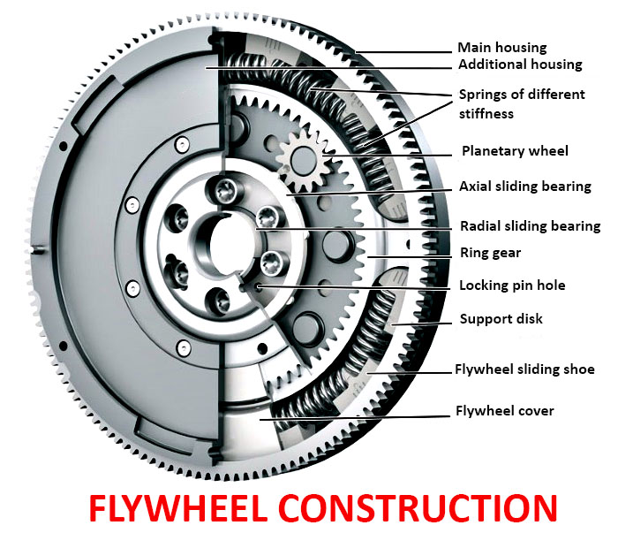
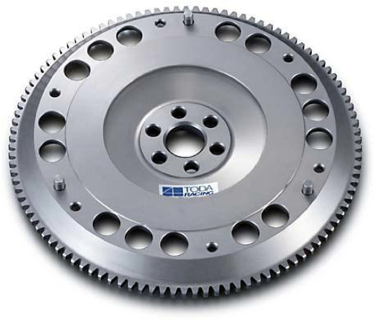
Flywheel – Design Constrain
The energy per unit volume at a given ω is
Both R and ω are fixed by the design, so the best material is now that with the greatest value of

Slide 13
Flywheel – Ashby Chart

Slide 14
Flywheel
Candidate materials with high values of M₁ lie in the search region towards the top left.
The best choices are unexpected ones:
composites, particularly CFRP, high strength titanium alloys and some ceramics, but these are ruled out by their low toughness.
But why lead flywheels for children’s toys? There could hardly be two more different materials than CFRP and lead: the one, strong and light,
the other, soft and heavy.
The angular velocity ω is limited instead by the drive mechanism (pull-string, friction drive). Then as we have seen, the best material is that with the largest density.
The second selection line on the chart → We seek materials in Search Area 2 to the
right of this line.
Lead is good. Cast iron is less good, but cheaper. Gold, platinum, and uranium (not shown on the chart) are better, but may be thought unsuitable for other reasons.

Slide 15
Alternative materials having High Energy Density

Slide 16


